Slide 1
Project Management Internship
Ronit Tonknogy VC1C
ronit324@gmail.com
Group 30

Slide 2
About The Internship Program
My project is about my internship with Northwell Health, my official title is IT&S Project Management Intern. I started the Internship on June 2023, and currently I work part time in my role. Northwell Health is a nonprofit integrated healthcare network that is New York State's largest healthcare provider and private employer. My daily tasks include of preparing documentation containing process flows, business requirements, functional specifications, test scripts, executing test scripts, and performing data validation. In addition, I also assist various stakeholders like business analysts, project managers, and developers with incoming tasks, handling technical support requests, preparing reports and crafting SQL queries.

Slide 3
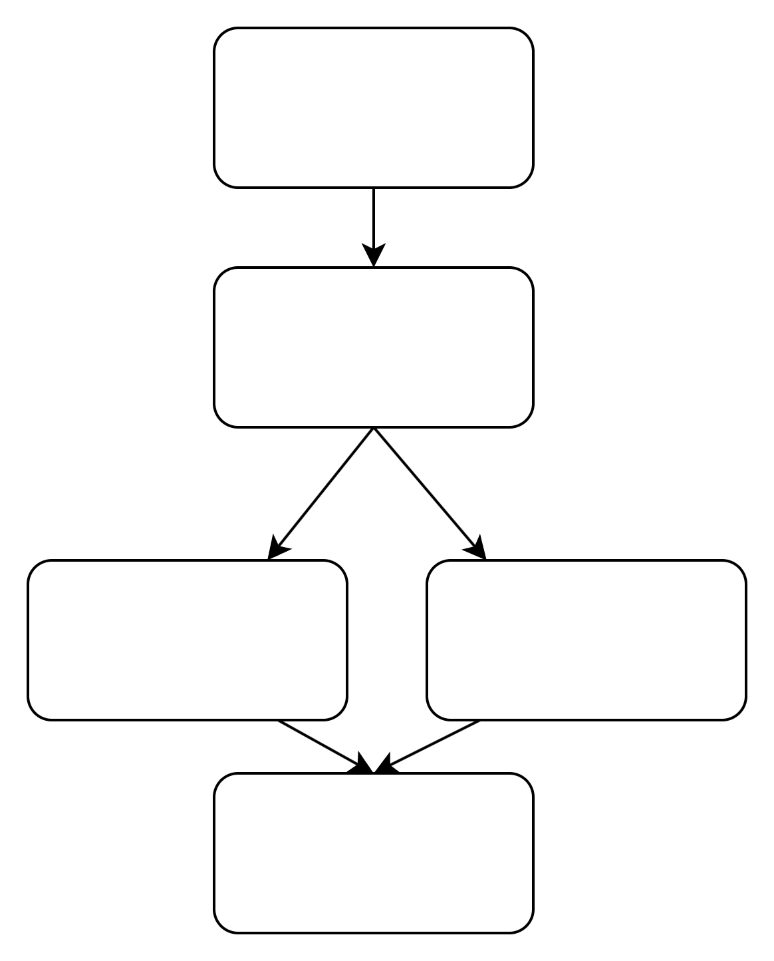
My Team’s Structure
Program Manager
Lead Project Manager
Business Analyst
Business Analyst
Project Management Intern - Me

Slide 4
Team Members’ Responsibilities
All roles collaborate and interact with each other.
The program manager makes sure everyone is meeting their deliverables, oversees the team, and provides guidance.
The Lead Project Manager is responsible for most of the project’s documentation and communication with clients.
The Business analysts are in charge of reports, development, tests, technical support, and support requests.
The Project Management Intern is working with all team members, shadowing and completing tasks.

Slide 5
Progress
I feel that I have immersed myself in the team, learned how to approach tasks independently and I feel comfortable working on every incoming task on my own. In March, my manager spoke with me about my objectives for the future. She told me that she is very happy with my work, my expertise in testing, my ability to grasp new information quickly, my adaptability, and the way I engage and get along with my colleagues. I have been offered a full-time position with Northwell Health. Currently, I am waiting for the contract, to start considering the position!

